Slide 1

brainSphere
Human Resources
Data Analysis

Slide 2

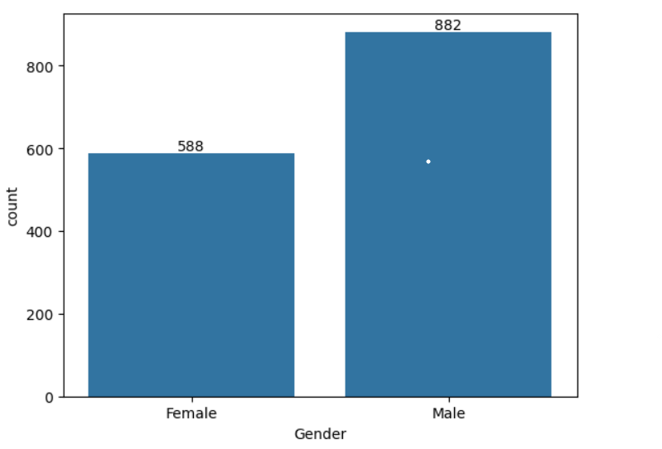
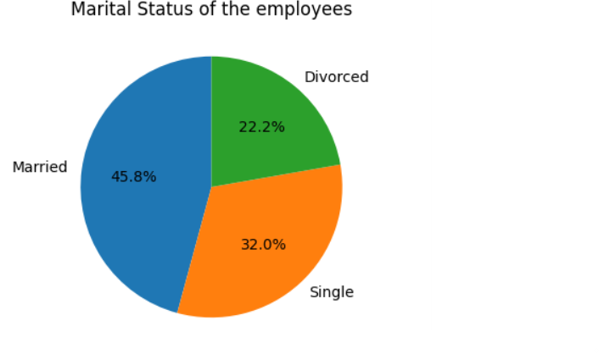
Total Number of Rows and Columns – 1470, 35
Total number of :
Female employees - 588
Male employees – 882
Martial Status of employees:
Married – 45.8%
Single - 32%
Divorced- 22.2%

Slide 3
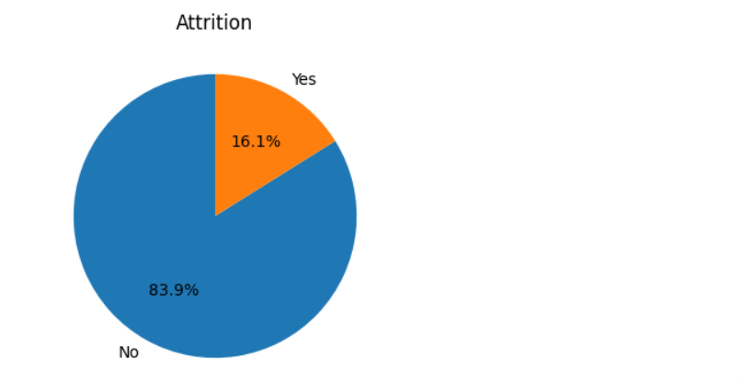
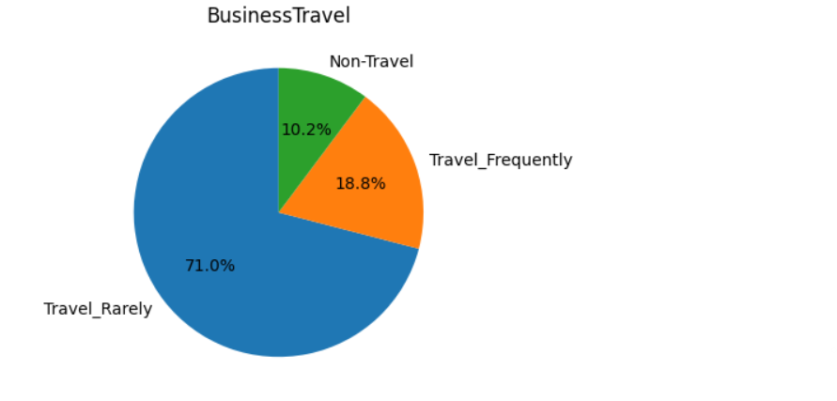
Attrition:
Yes-16.1%
No- 83.9%
Business Travel
Travel Rarely-71%
Travel Frequently-18.8%
Non-Travel- 10.2%

Slide 4
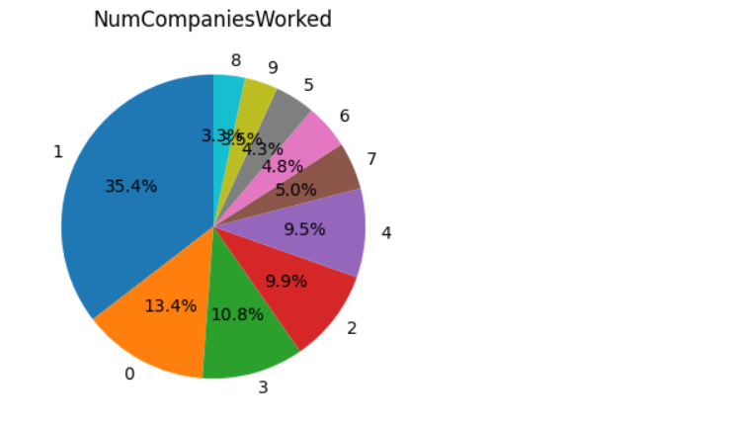
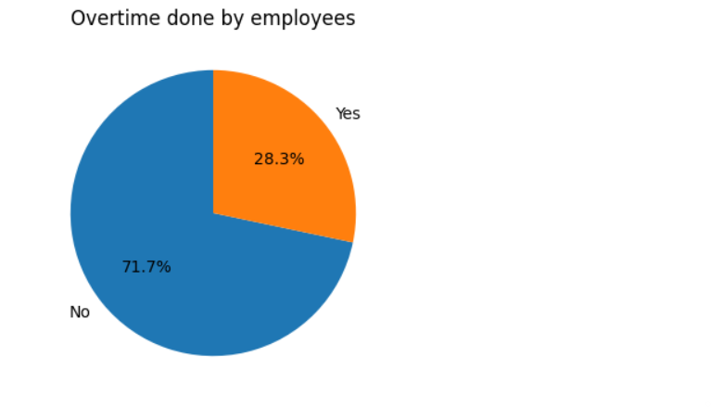
There are around 13.4% of employees for which this is the first company and 3.5% of employees for which this is the 9 company.
Overtime done by employees:
Yes- 28.3%
No- 71.7%

Slide 5
Job Satisfaction is more in the Role of Sales Executive and least in the Human Resources.
Performance Ratings are highest in the Research and Development Department and least in the Human Resources.
Percent Salary Hike in the employees are bit uneven for the years they spent in the company.
Work Life Balance with the age is decent.

Slide 6
Thank You
Team Name: BrainSphere
Yash Kumar
Kanishka Shashi

